Slide 1
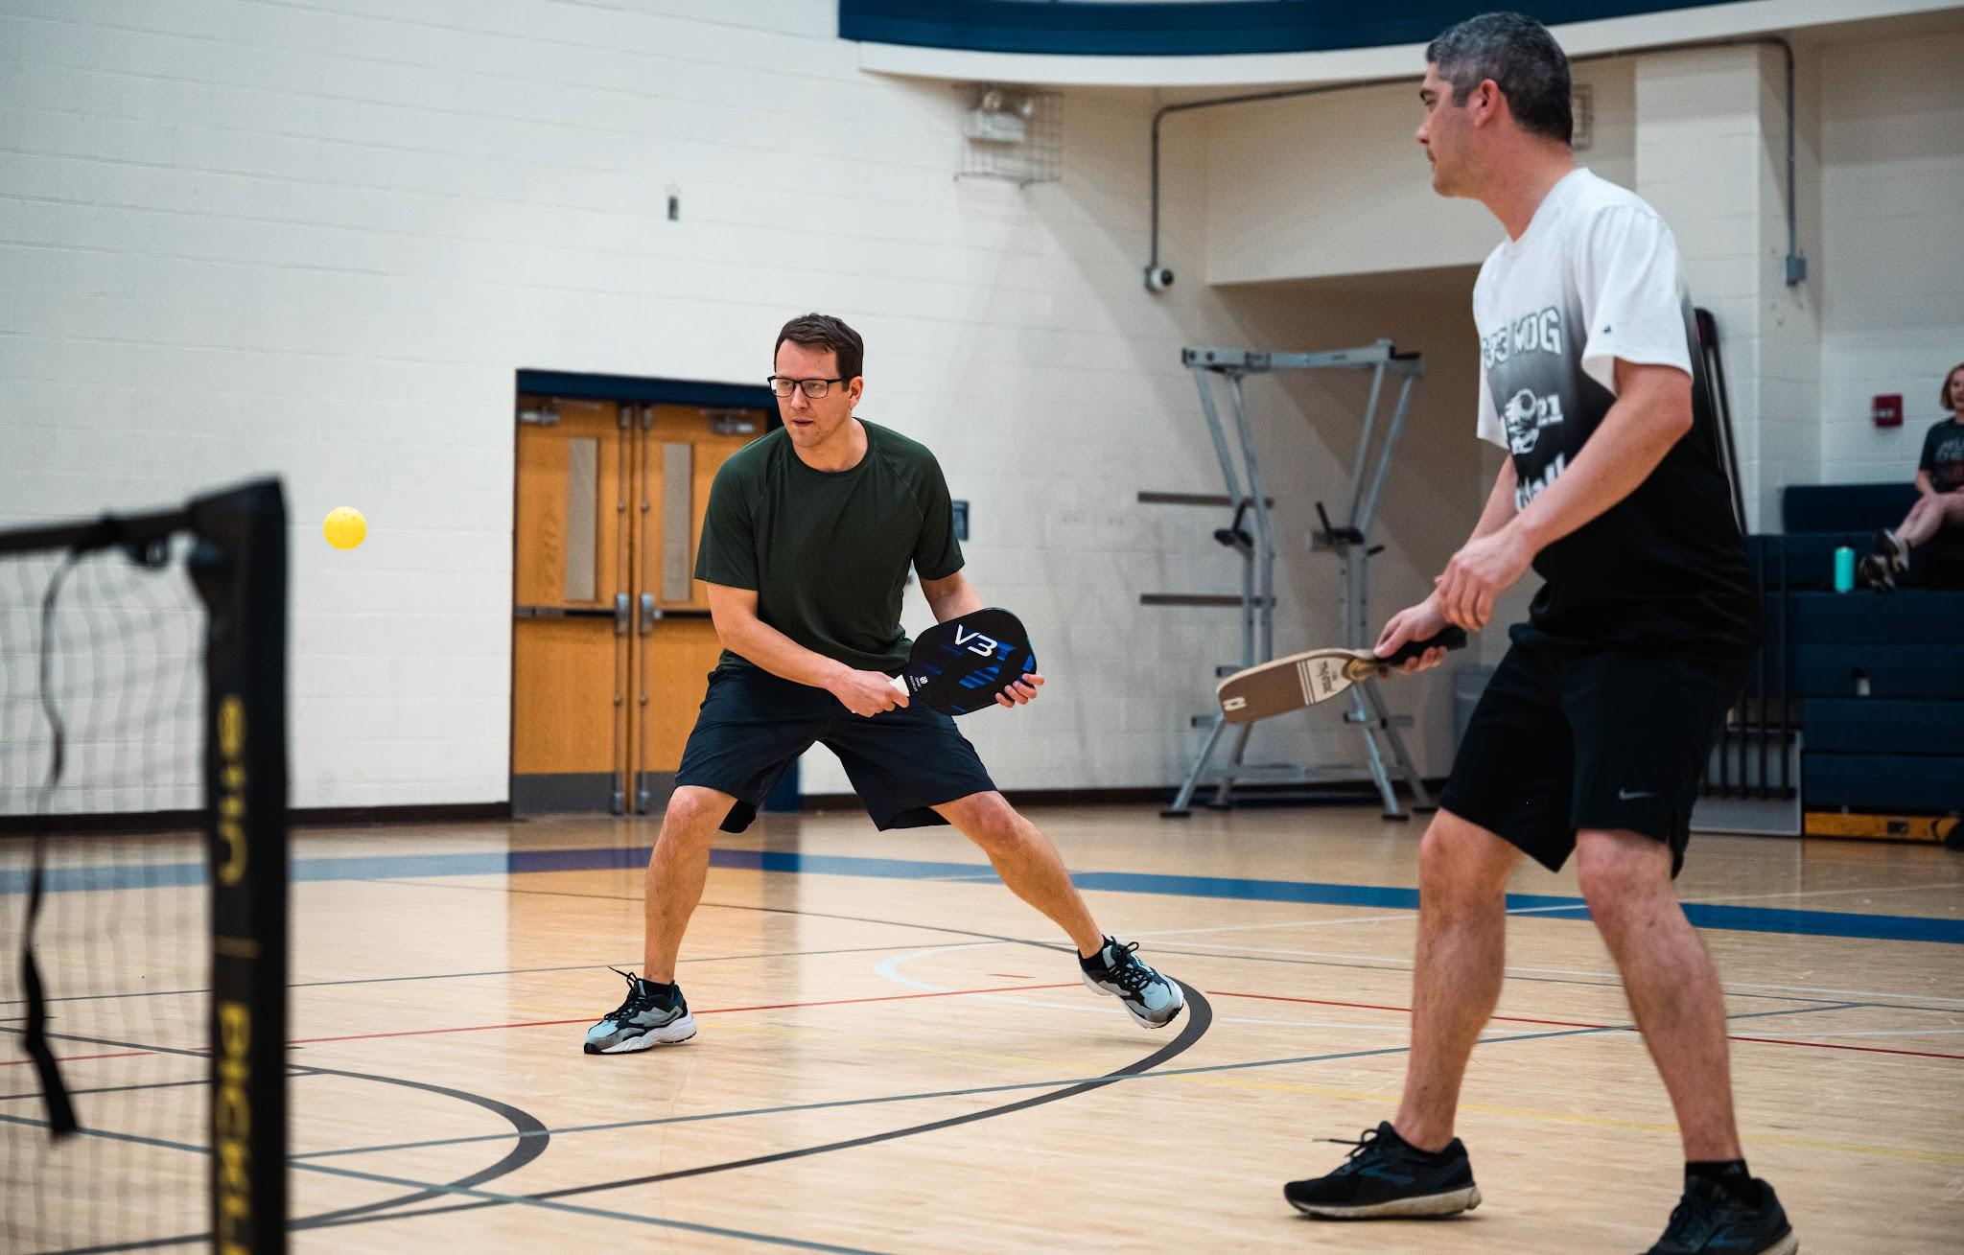
PICKLEBALL ANALYSIS SYSTEM
Revolutionizing Pickleball Performance Analysis with AI

Slide 2

ABOUT ME
NAME- R.ARIVANANDAM
LOCATION – CHENNAI , INDIA
EDUCATION – Int.Msc.Data Science (pursuing)
TECHNICAL INTEREST – Computer vision, deep learning, data analysis, sports analytics
HOBBIES – Graphic designing , Avid Pickleball Player
LINKEDIN -www.linkedin.com/in/arivanandam-r-66b80b224
GITHUB - https://github.com/arivsssss
我提前表示歉意，由于语言障碍，我可能很难解释清楚我的想法，但请多多包涵。我有一个非常好的商业想法，可以改革匹克球的体育分析领域。

Slide 3
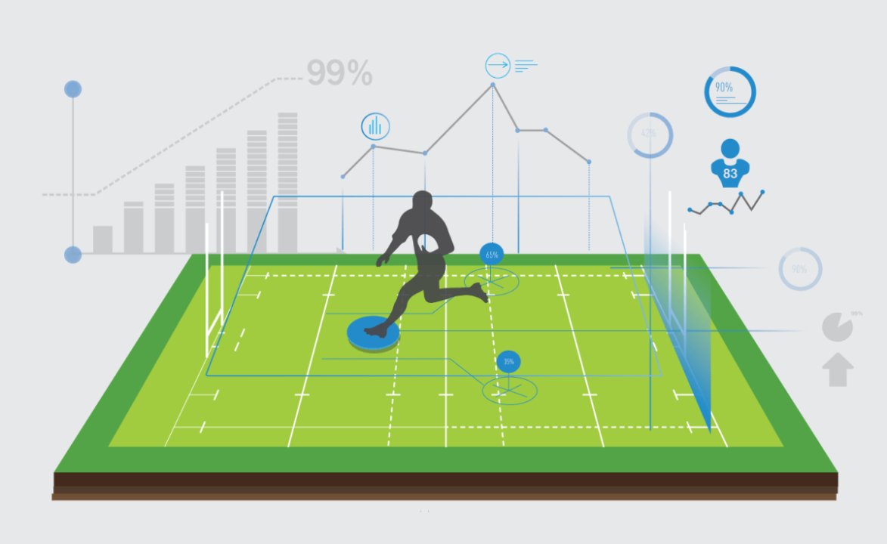
The Problem & Opportunity
Growing popularity of pickleball - It has started more than a trend.
Current lack of sophisticated analysis tools - To stand out among competitors analysis tools could be the easily accessible and faster analysis
Market gap for performance analytics- Lack of tools to for performance analytics in market paves way for a boom with this technology

Slide 4
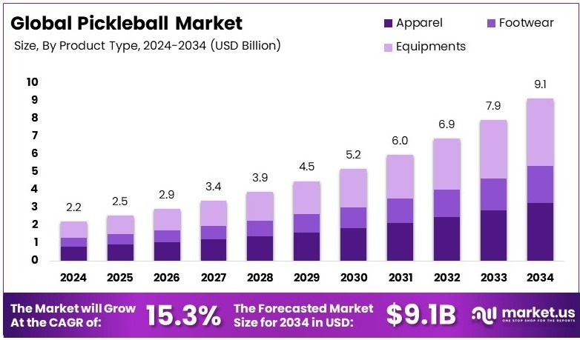
OUR SOLUTION
AI POWERED ANALYSIS SYSTEM USING SURVEILLANCE CAMERA FOOTAGES
EASY TO SET UP IF PROPERLY TRAINED
CAN BE DEPLOYED ON LOCAL CAMERA USING RASPBERRY PI or BY SENDING LIVE FOOTAGE TO CLOUD AND RESULTS ARE SEND BACK

Slide 5
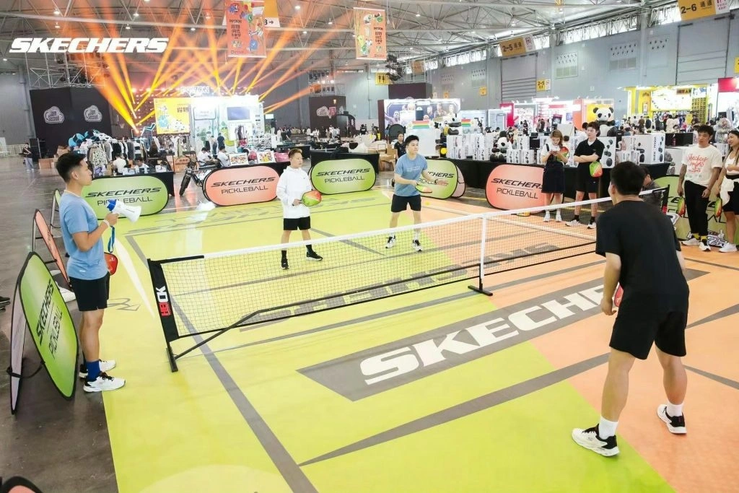
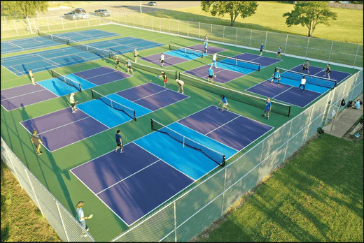
THE WHOLE IDEA
THE WHOLE IDEA IS CENTERED AROUND PRIVATELY OWNED TURFS THAT CHARGE PLAYERS FOR SLOT TIMINGS.
GROWING NUMBER OF CASUAL PLAYERS - INCREASING NUMBER OF TURFS ALL OVER THE GLOBE.
NO PROPER WAY TO EVALUATE THE PLAYER PERFORMANCE AFTER THE GAME LIKE PROFESSIONALS DO.

Slide 6
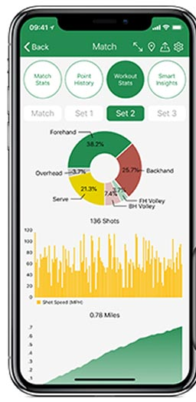
THE WHOLE IDEA
SERVICES THAT WE WANT TO OFFER:
PLAYER INSIGHTS - INSIGHTS ON HOW THE PLAYER PLAYED DURING THEIR SLOT TIME.
BROADCASTING - TRACK REAL TIME PLAYING AND BROADCAST WITH INSIGHTS FOR SMALL CLUB GAMES WITH MINIMAL HUMAN INTERVENTION.
REPORT GENERATION - SENDING ANALYSIS REPORT IN A EASILY UNDERSTANDABLE FORMAT THAT CAN BE POSTED ON SOCIAL MEDIA THEREBY IMPROVING USER EXPERIENCE

Slide 7
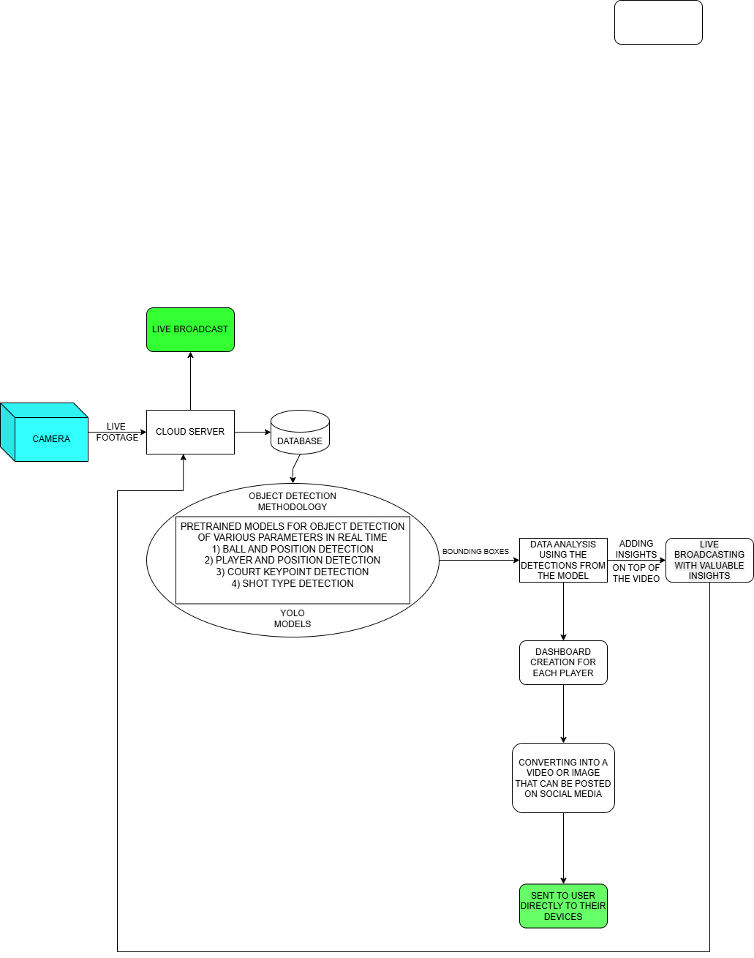
DATA WORKFLOW- CLOUD BASED

Slide 8
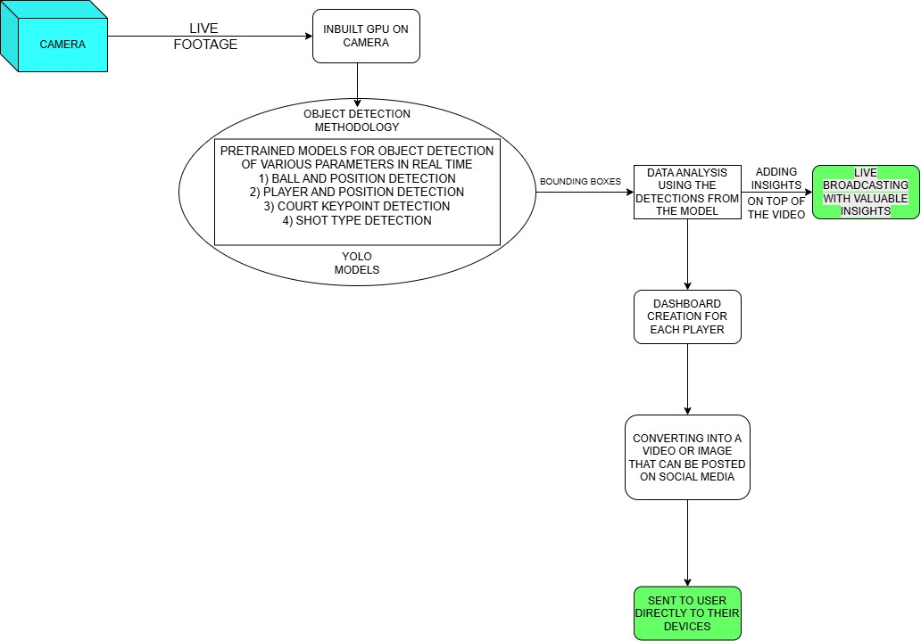
DATA WORKFLOW - LOCAL

Slide 9
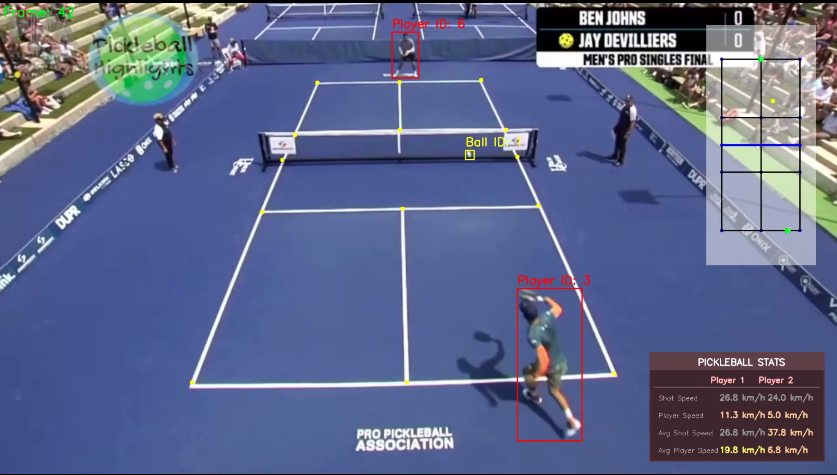
OBJECT DETECTION METHODOLOGY
SYSTEM ARCHITECTURE
Core Components:
Player Tracking (YOLO)
Ball Detection (Custom YOLO)
Court Line Detection (CNN)
Mini-Court Visualization
Performance Analytics

Slide 10
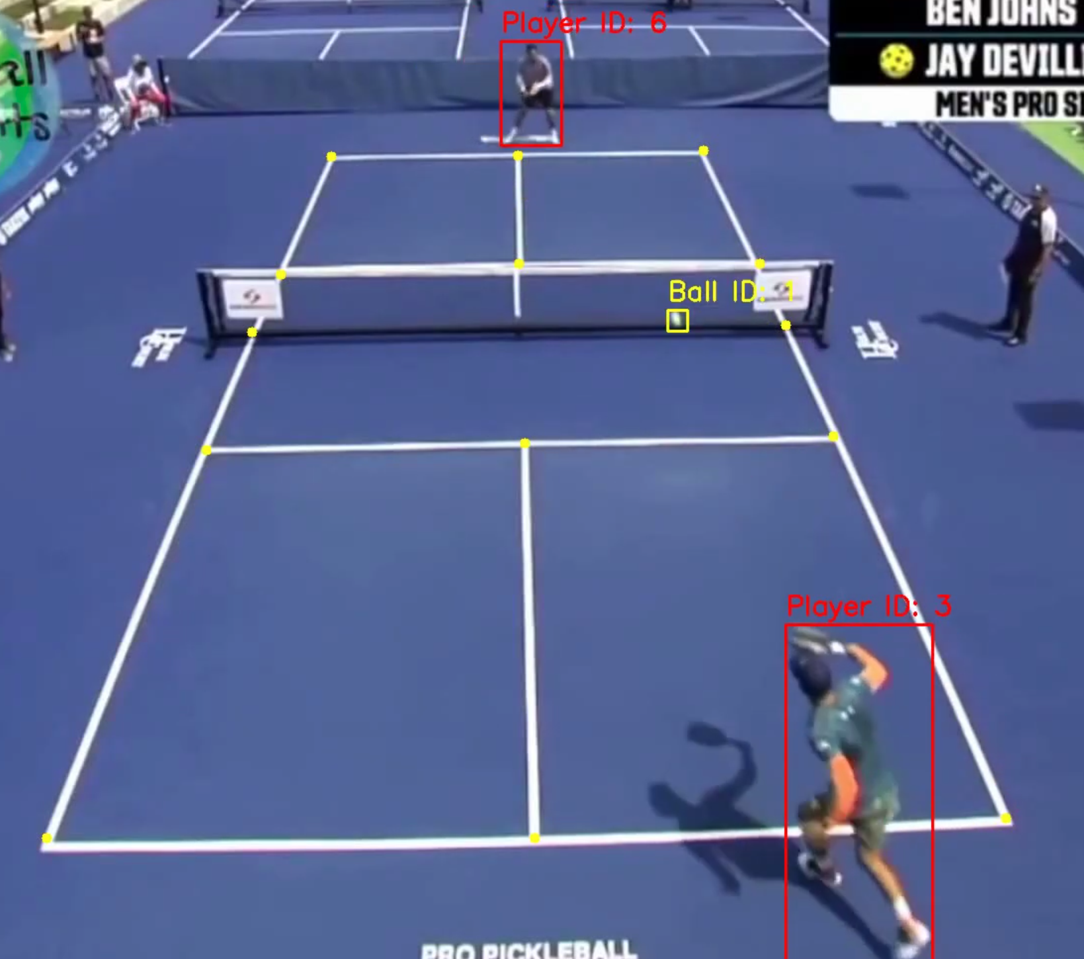
Court Line Detection
CNN Architecture (ResNet50-based)
14 keypoint detection
Court line mapping
Perspective transformation
Real-time line tracking

Slide 11
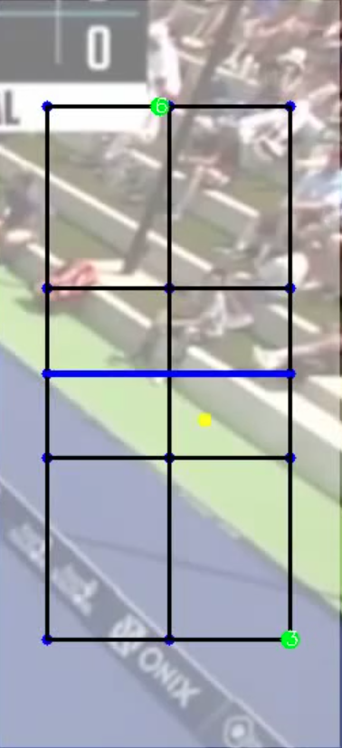
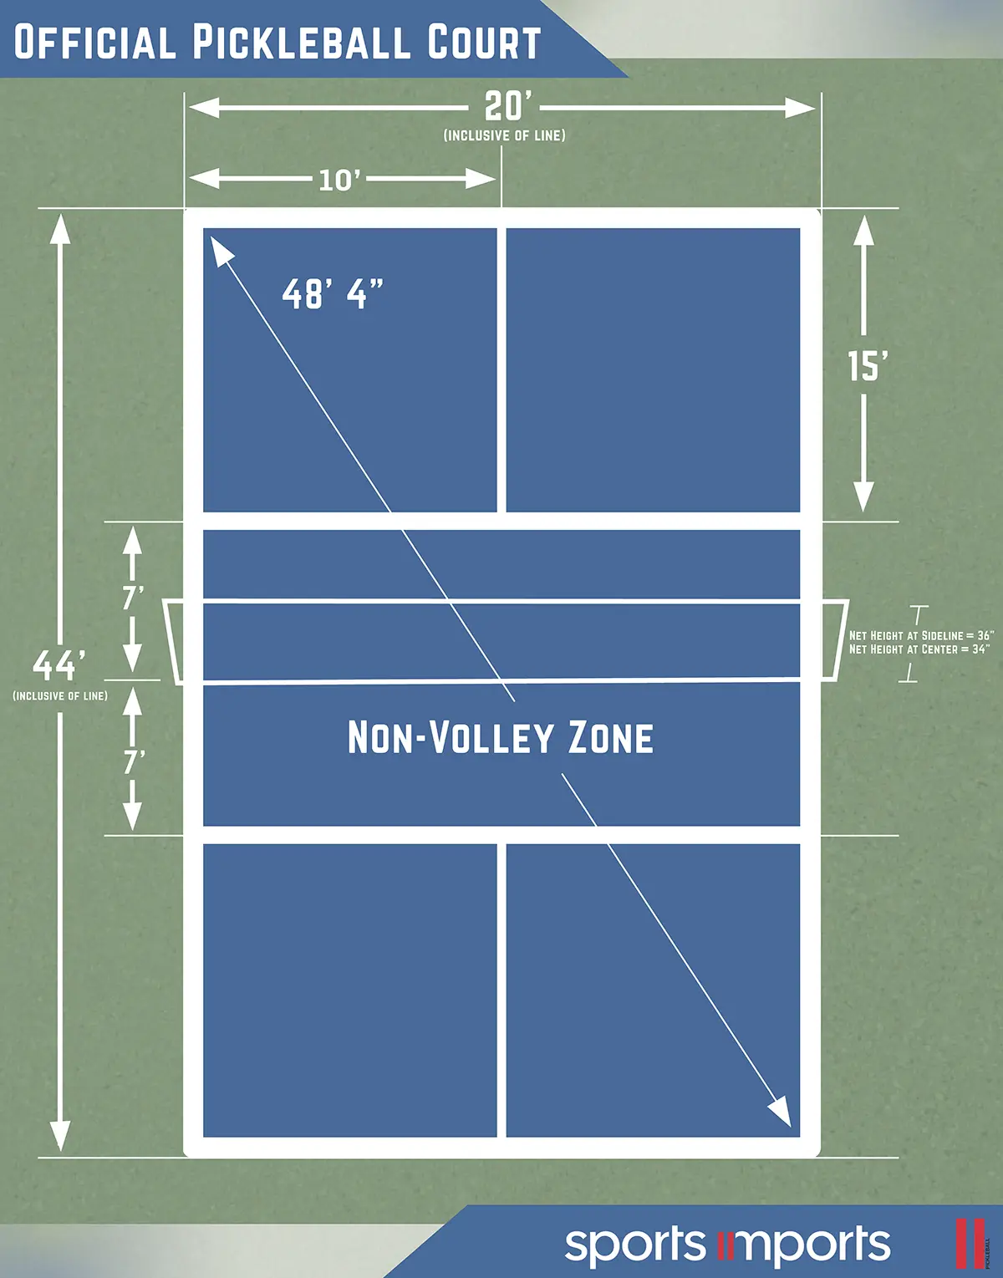


Slide 12
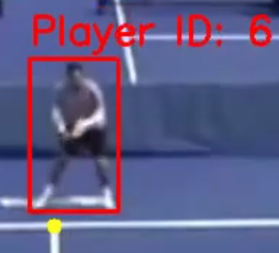
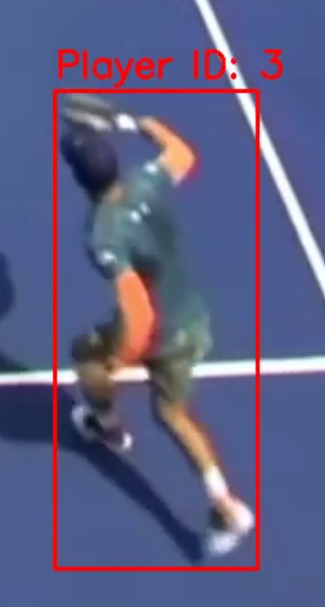
Player Tracking System
Custom YOLO Model Architecture
Real-time player detection
Bounding box tracking
Player ID assignment
Movement vector calculation

Slide 14
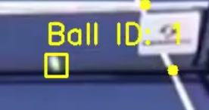
Ball Tracking System
Custom YOLO Model Architecture
Ball detection and tracking
Position interpolation
Shot detection algorithm
Speed calculation

Slide 16
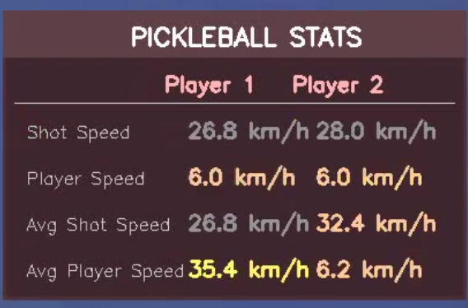
Performance Analytics
Player speed calculation
Ball speed analysis
Shot detection
Performance metrics computation

Slide 18
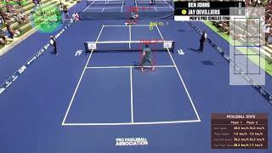

Slide 19
BUSSINESS IDEA FOR WARPING POINT
CLOUD BASED
CAN AUTOMATE THE PROCESS OF INSIGHTS BY CONNECTING WITH PRIVATE OWNED TURFS
TO PROVIDE:
1) DATA ANALYSIS AS A SERVICE
2) BROADCASTING AS A SERVICE

Slide 20
BUSSINESS IDEA FOR WARPING POINT
LOCAL DEPLOYMENTBASED
PRODUCT AS A SERVICE:
CAN DESIGN CAMERAS THAT SUPPORT AND INTEGRATE THE PROCESS OF INSIGHTS AND SELL THESE AS PRODUCTS TO TURF BUSSINESSES

